Slide 1
Online Food Delivery System
Team Leader: Nikita Mane
Enrollment No. : EBEON1222703288
Name | Enrollment No
Nikita Mane | EBEON1222703288
Aditi Pawar | EBEON1222703280
Rashmi Shingate | EBEON1222703290
Sapana Shinde | EBEON1222703323
Vaishnavi Dhanawade | EBEON1222703304
Guided by
Varadharajan sir

Slide 2
Online Food Delivery System
Login Module
Admin Module
Home Page
Add to Cart/ Order module
View product module
Payment module
Change Details
About us , Contact us

Slide 3
Online Food Delivery System
1)Login module:
a)User Registration
b)Forgot Password
2)Admin module:
a)product:
1)View Product
2)Add Product
b)Order :
1)View All Orders
2)View Pending Orders
3)View Delivered orders
3)Home Page:
a)View All Product

Slide 4
Presenting Module 1
Login module
a)User Registration
b)Forgot Password

Slide 5
Module 2
2)Admin Module:
a)Products: 1)View Products 2)Add Products
b)Order : 1)View all orders 2)View Pending orders 3)View Delivered Orders
c)Customer :1) View Customer

Slide 6
Module 3
3)Home page:
a) View all products

Slide 7
Module 4
3)Change Details:
a) Change Password
b) Add or change Address
c) Change Security Question
d) Change Mobile Number

Slide 8
Module 4
4) Contact Us :
User can send the Feedback Or Queries.

Slide 9
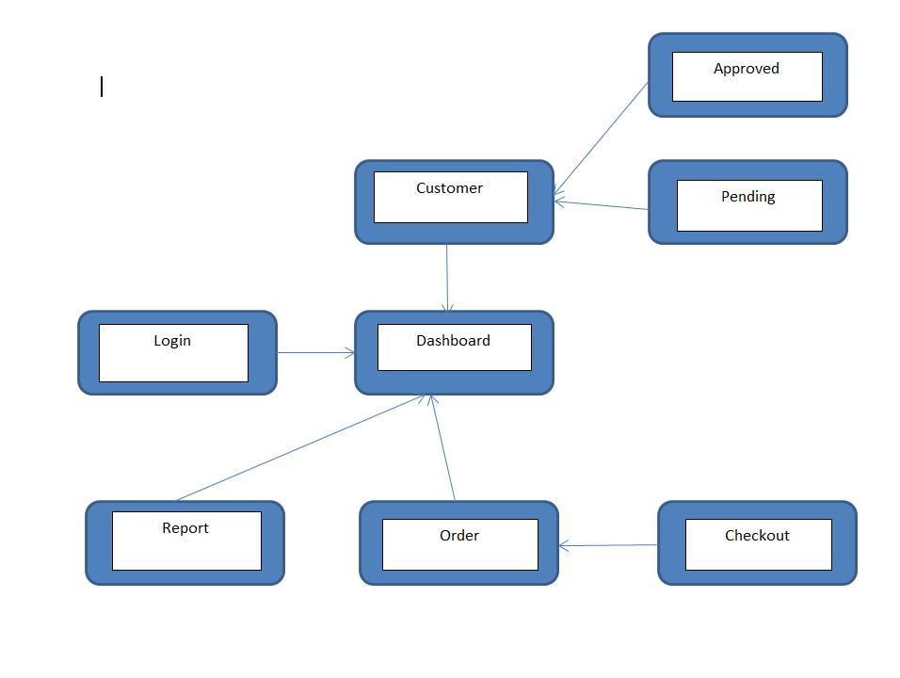
Project overview

Slide 10
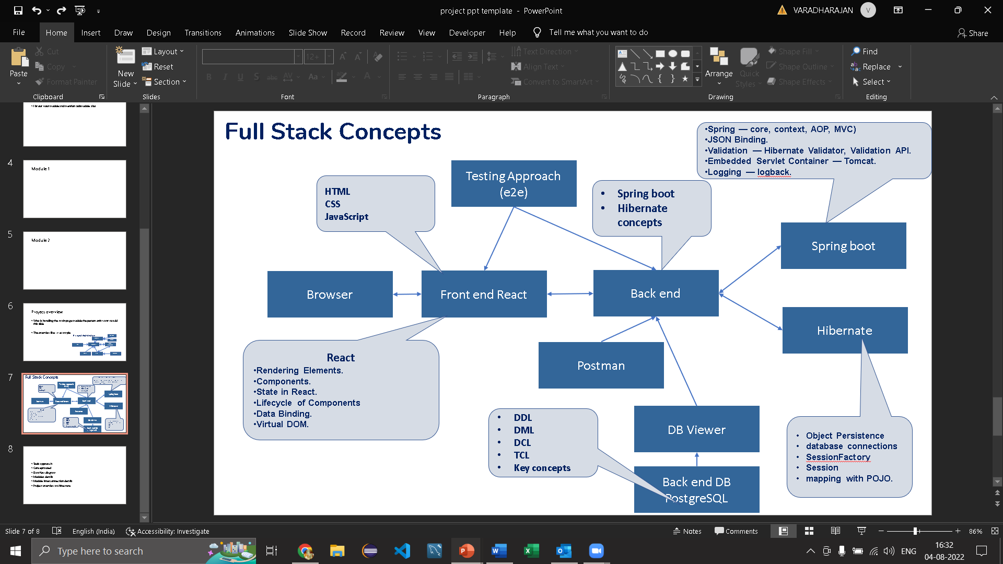
Tech architecture

Slide 11
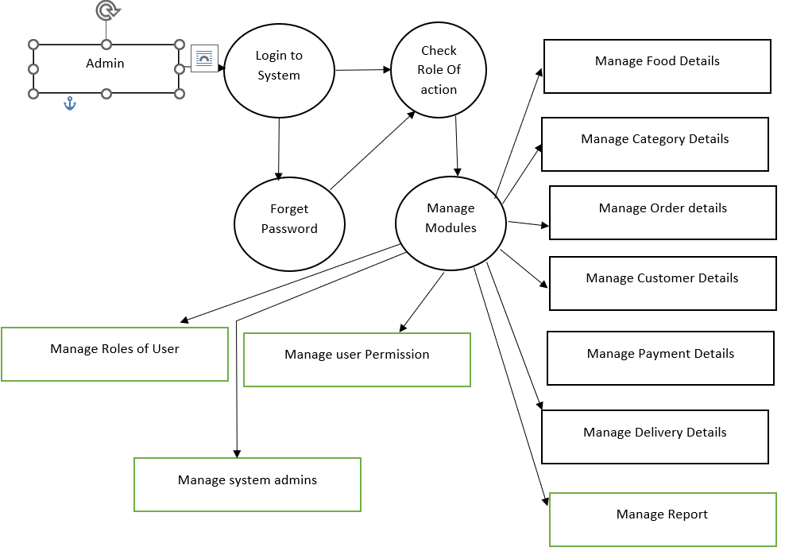
Dataflow diagram Admin Module

Slide 12
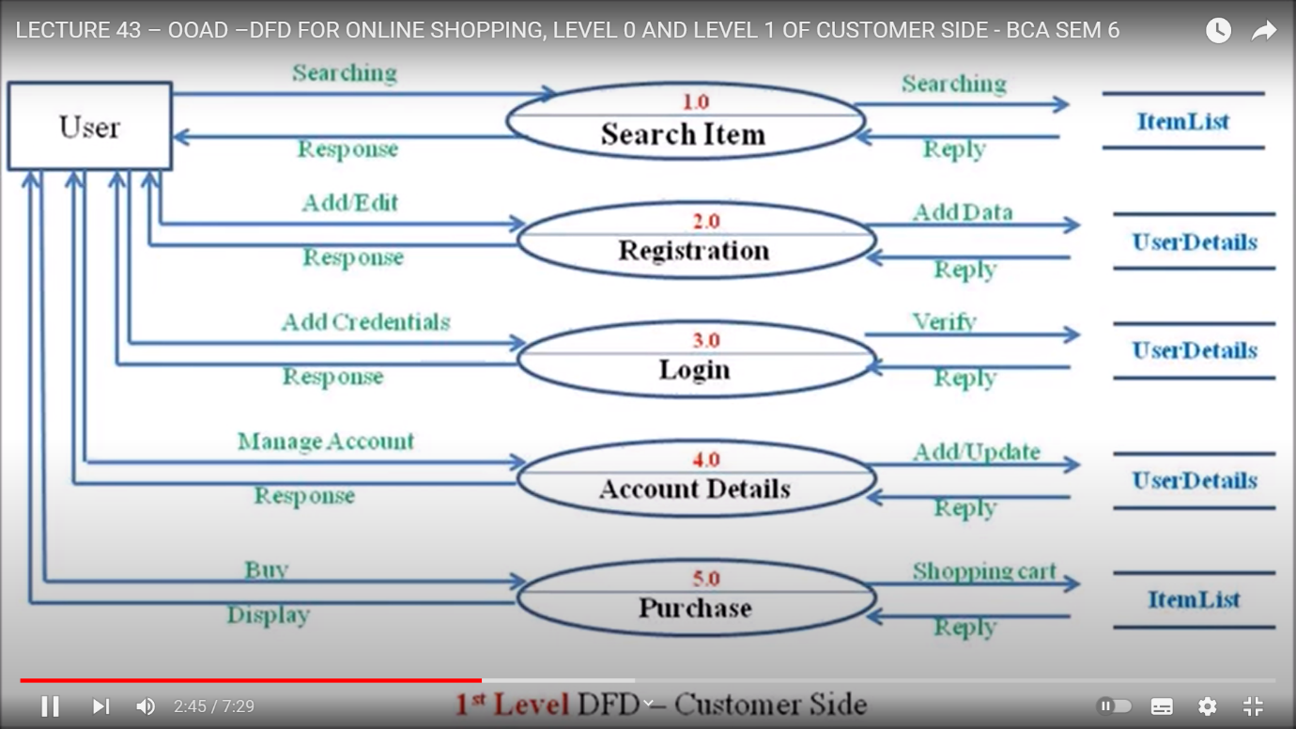
Dataflow diagram User Module

Slide 13
Challenging issues
1) While Running project port no. problem
2)Issues faced during database connectivity
3)Changes made in code are not reflected into live Project

Slide 14
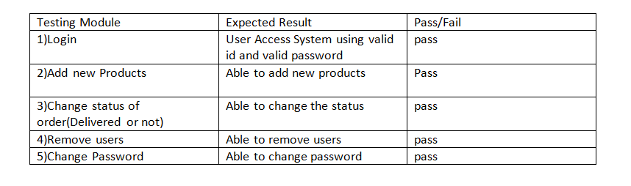
Testing

Slide 15
Future enhancement
1. Real-Time GPS Tracking
Real-time GPS tracking is one of the essential features of food delivery apps that enable customers to track the location of their food in real-time. The purpose of GPS is to offer two-way tracking as well as functioning.
2. Social Media Integration
There’s no doubt that in the past few years, social media has contributed a lot to online marketing. It is one of those unpretentious viewpoints which improve customers’ decisions. With social media integration, customers can easily share photos or videos of their favorite dishes with friends and family
3. Order scheduling and pickup
The order scheduling and pickup feature are handy for such situations. Using it, they can schedule the order at their convenience and pick it up on the way home from the office. This way, they can save precious time and ensure they enjoy a warm, romantic dinner with their significant other.

Slide 16
Conclusion
Online food delivery websites are becoming increasingly popular due to their convenience and time-saving features.
This project is made in such a way that it is easy to use/ handle for new users
Person with little technical knowledge can also use/ interact with this project
User Friendly GUI.

